Slide 1
Graph Data Stucture

Slide 2

Graph Data Stucture
A graph data structure is a collection of nodes that have data and are connected to other nodes.
More precisely, a graph is a data structure (V, E) that consists of
  A collection of vertices V
  A collection of edges E, represented as ordered pairs of vertices (u,v)
In the graph,
V = {0, 1, 2, 3}
E = {(0,1), (0,2), (0,3), (1,2)}
G = {V, E}

Slide 3
Graph Terminology
Adjacency: A vertex is said to be adjacent to another vertex if there is an edge connecting them.
  Vertices 2 and 3 are not adjacent because there is no edge between them.
Path: A sequence of edges that allows you to go from vertex A to vertex B is called a path.
  0-1, 1-2 and 0-2 are paths from vertex 0 to vertex 2.
Directed Graph: A graph in which an edge (u,v) doesn't necessarily mean that there is an edge (v, u) as well. The edges in such a graph are represented by arrows to show the direction of the edge.

Slide 4
Path: a sequence of vertices that connect two nodes in a graph
Complete graph: a graph in which every vertex is directly connected to every other vertex
simple path: no repeated vertices

Slide 5
Applications of Graph Data Structure
In Computer science graphs are used to represent the flow of computation.
Google maps uses graphs for building transportation systems, where intersection of two(or more) roads are considered to be a vertex and the road connecting two vertices is considered to be an edge, thus their navigation system is based on the algorithm to calculate the shortest path between two vertices.
In Facebook, users are considered to be the vertices and if they are friends then there is an edge running between them. Facebook’s Friend suggestion algorithm uses graph theory. Facebook is an example of undirected graph.
In World Wide Web, web pages are considered to be the vertices. There is an edge from a page u to other page v if there is a link of page v on page u. This is an example of Directed graph. It was the basic idea behind Google Page Ranking Algorithm.
In Operating System, we come across the Resource Allocation Graph where each process and resources are considered to be vertices. Edges are drawn from resources to the allocated process, or from requesting process to the requested resource. If this leads to any formation of a cycle then a deadlock will occur.

Slide 6
Practical Applications of Graph Data Structures in Real Life
Social Graphs
  Social graphs draw edges between you and the people, places and things you interact with online.
Knowledge Graphs
  Google's Knowledge Graph
  A knowledge graph has something to do with linking data and graphs...some kind of graph-based representation of knowledge. It still isn't what is can and can't do yet.
Recommendation Engines
  Yelp's Local Graph
    Yelps has been slowly phasing out their old Fusion API for a GraphQL API.
    The Local Graph API promises to make it easier for developers to integrate Yelp's data and share great local businesses through their apps.
Path Optimization Algorithms
  Path optimizations are primarily occupied with finding the best connection that fits some predefined criteria e.g. speed, safety, fuel etc or set of criteria e.g prodecures, routes.
Scientific Computations

Slide 7
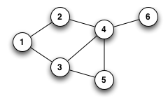
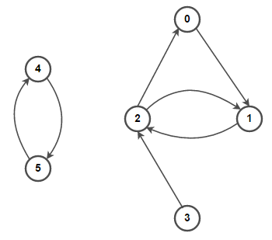
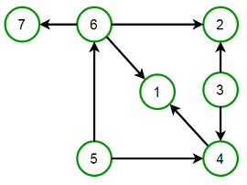
Types of Graphs:
1. Undirected graph
An undirected graph (graph) is a graph in which edges have no orientation. The edge (x, y) is identical to edge
(y, x) , i.e., they are not ordered pairs. The maximum number of edges possible in an undirected graph without a
loop is n×(n-1)/2 .
2. Directed graph
A Directed graph (digraph) is a graph in which edges have orientations, i.e., The edge (x, y) is not identical to edge
(y, x)
3. Directed Acyclic Graph (DAG)
A Directed Acyclic Graph (DAG) is a directed graph that contains no cycles.

Slide 8
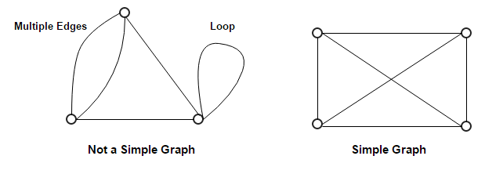
4. Multi graph
A multigraph is an undirected graph in which multiple edges (and sometimes loops) are allowed. Multiple edges are
two or more edges that connect the same two vertices. A loop is an edge (directed or undirected) that connects a
vertex to itself; it may be permitted or not.
5. Simple graph
A simple graph is an undirected graph in which both multiple edges and loops are disallowed as opposed to a
multigraph. In a simple graph with n vertices, every vertex’s degree is at most n-1 .

Slide 9
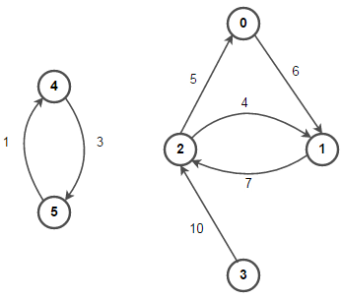
6. Weighted and Unweighted graph
A weighted graph associates a value (weight) with every edge in the graph. We can also use words cost or length
instead of weight.
An unweighted graph does not have any value (weight) associated with every edge in the graph. In other words, a
weighted graph is a weighted graph with all edge weight as 1. Unless speciÕed otherwise, all graphs are assumed to be
unweighted by default.
weighted graph
unweighted graph

Slide 10
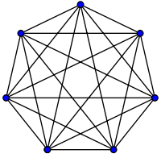
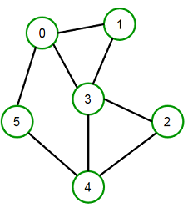
7. Complete graph
A complete graph is one in which every two vertices are adjacent: all edges that could exist are present.
8. Connected graph
A Connected graph has a path between every pair of vertices. In other words, there are no unreachable vertices. A
disconnected graph is a graph that is not connected.

Slide 11
Most commonly used terms in Graphs:
An edge is (together with vertices) one of the two basic units out of which graphs are constructed. Each edge has two vertices to which it is attached, called its endpoints.
Two vertices are called adjacent if they are endpoints of the same edge.
Outgoing edges of a vertex are directed edges that the vertex is the origin.
Incoming edges of a vertex are directed edges that the vertex is the destination.
The degree of a vertex in a graph is the total number of edges incident to it.
In a directed graph, the out-degree of a vertex is the total number of outgoing edges, and the in-degree is the total number of incoming edges.
A vertex with in-degree zero is called a source vertex, while a vertex with out-degree zero is called a sink vertex.
An isolated vertex is a vertex with degree zero, which is not an endpoint of an edge.
Path is a sequence of alternating vertices and edges such that the edge connects each successive vertex.
Cycle is a path that starts and ends at the same vertex.

Slide 12
Simple path is a path with distinct vertices.
A graph is Strongly Connected if it contains a directed path from u to v and a directed path from v to u for every pair of vertices u , v .
A directed graph is called Weakly Connected if replacing all of its directed edges with undirected edges produces a connected (undirected) graph. The vertices in a weakly connected graph have either out-degree or indegree of at least 1.
Connected component is the maximal connected subgraph of an unconnected graph.
A bridge is an edge whose removal would disconnect the graph.
Forest is a graph without cycles.
Tree is a connected graph with no cycles. If we remove all the cycles from DAG (Directed Acyclic Graph), it becomes a tree, and if we remove any edge in a tree, it becomes a forest.
Spanning tree of an undirected graph is a subgraph that is a tree that includes all the vertices of the graph.

Slide 13
Relationship between number of edges and vertices:
For a simple graph with m edges and n vertices, if the graph is
directed, then m = n×(n-1)
undirected, then m = n×(n-1)/2
connected, then m = n-1
a tree, then m = n-1
a forest, then m = n-1
complete, then m = n×(n-1)/2
herefore, O(m) may vary between O(1) and O(n ), depending on how dense the graph is.

Slide 14
GRAPH REPRESENTATIONS
a) Set representation.
b) Linked representation.
c) Sequential (matrix) representation.

Slide 15
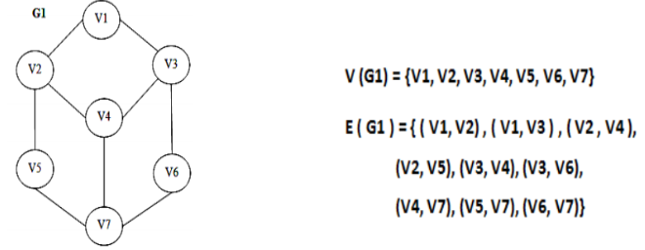
SET REPRESENTATION
In set representation, 2 sets are maintained,
(i) V, is the set of vertices in G
(ii) E, is the set of edges in G
which is the subset VXV.
If the graph is weighted, the set E is the ordered
collection of 3 values as, W X V X V, where ‘W’ is
the set of weights

Slide 16
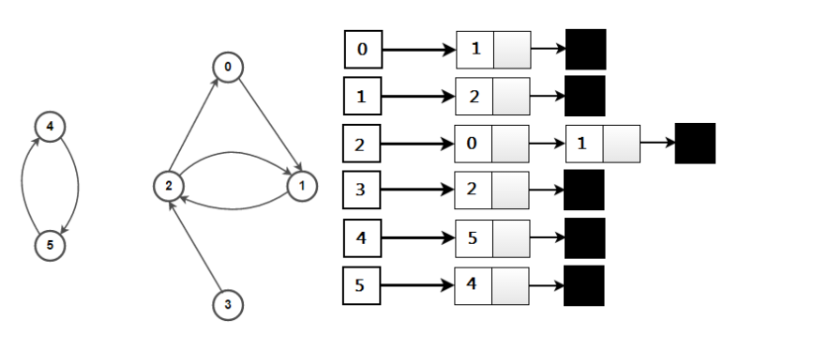
2. Adjacency List Representation:
An adjacency list representation for the graph associates each vertex in the graph with the collection of its neighboring vertices or edges, i.e., every vertex stores a list of adjacent vertices. There are many variations of adjacency list representation depending upon the implementation. This data structure allows the storage of additional data on the vertices but is practically very efficent when the graph contains only a few edges.

Slide 17
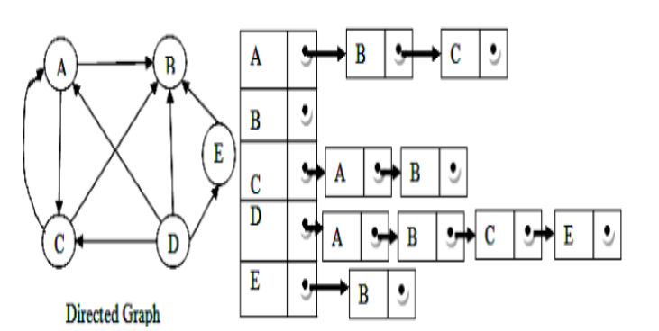
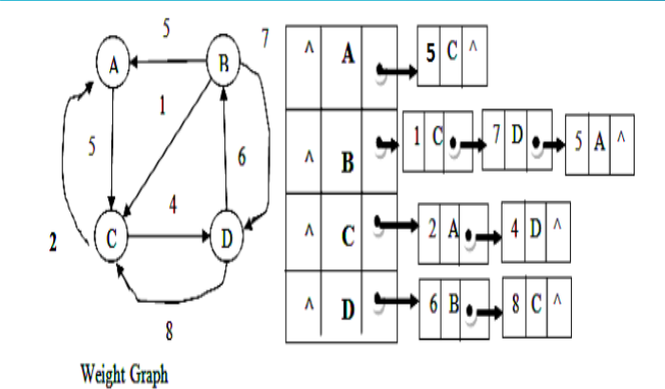

Slide 18
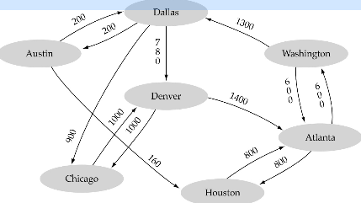
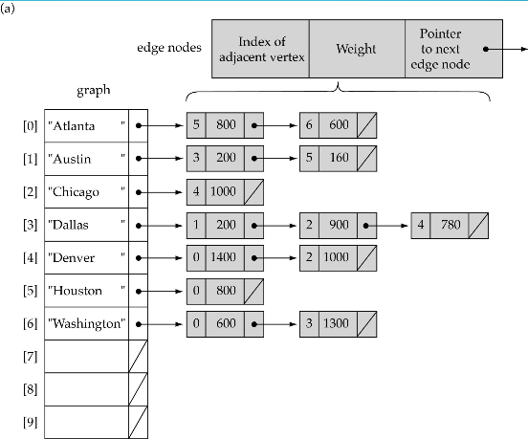
Linked-list implementation
A 1D array is used to represent the vertices
A list is used for each vertex v which contains the
vertices which are adjacent from v (adjacency list)

Slide 19
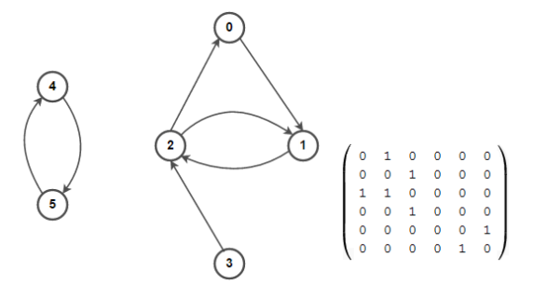
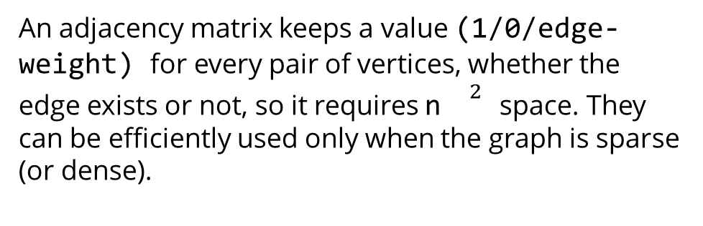
Adjacency Matrix Representation:
An adjacency matrix is a square matrix used to represent a Õnite graph. The elements of the matrix indicate whether pairs of vertices are adjacent or not in the graph.
Definition:
For a simple unweighted graph with vertex set V , the adjacency matrix is a square |V| × |V| matrix A such that its element:
A = 1 , when there is an edge from vertex i to vertex j , and
A = 0 , when there is no edge.
Each row in the matrix represents source vertices, and each column represents destination vertices. The diagonal elements of the matrix are all zero since edges from a vertex to itself, i.e., loops are not allowed in simple graphs. If the graph is undirected, the adjacency matrix will be symmetric. Also, for a weighted graph, A can represent edge
weights.
An adjacency matrix keeps a value (1/0/edge-weight) for every pair of vertices, whether the edge exists or not, so it requires n${}^{2}$ space. They can be efficiently used only when the graph is sparse (or dense).

Slide 20
